Slide 1







Enterprise Blockchain Developers (Intermediate)
In support of
Powered By

Slide 2
Outline
A Typical Blockchain Application Diagram
A Typical Web Application Diagram
Difference
What is Software Archtecture?
Solutions
© 2017-2020 SmartMesh Foundation Pte. Ltd. | MeshBox Foundation Pte. Ltd.

Slide 3
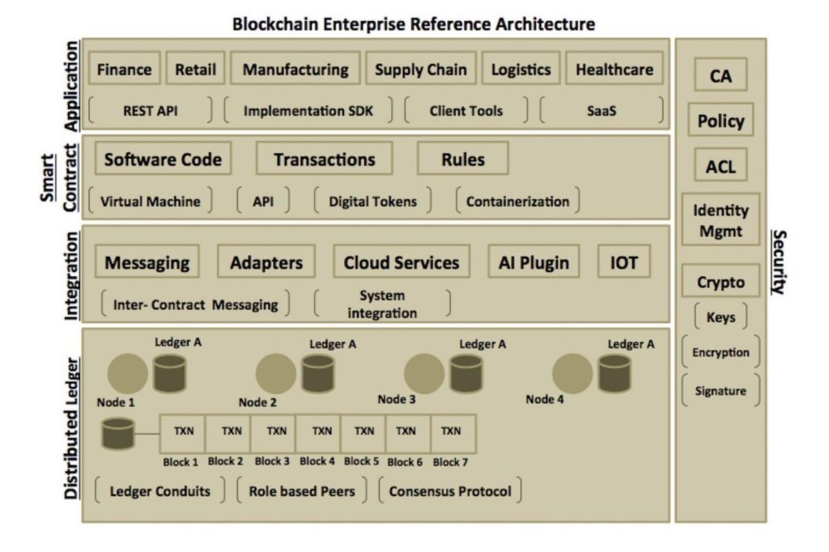
A Typical Blockchain Application Diagram

Slide 4
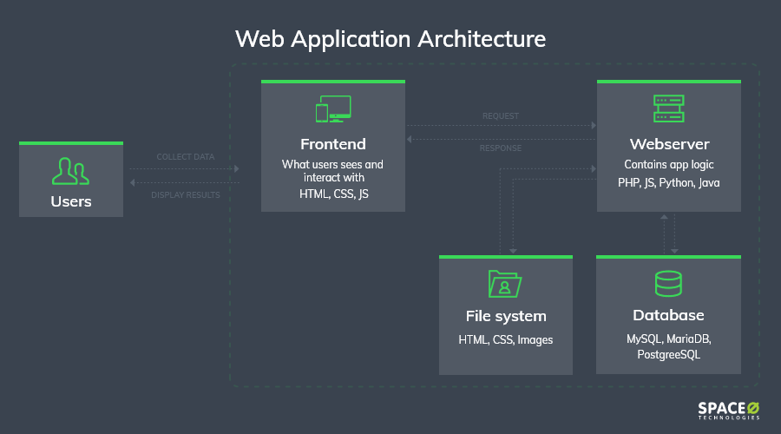
A Typical Web Application Diagram

Slide 5
Difference?
Pure Blockchain Applications:
Smart contract + Ledger
Web App:
Webserver/ backend + database
the clients are the same
Therefore, blockchain is just a programble, immutable, transparent database, comparing with triditional databases of a web app
So we can use hybrid architecture design thinking to solve different business problems

Slide 6
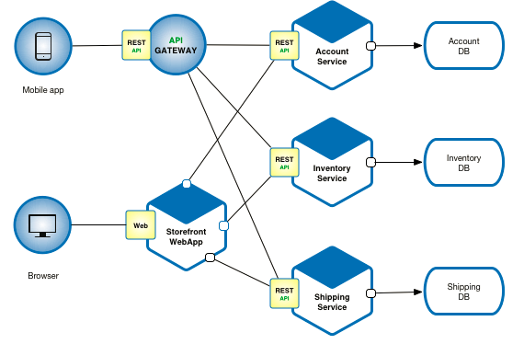
What is Software Archtecture?
Software architecture refers to the fundamental structures of a software system and the discipline of creating such structures and systems.
Example: Micro Services

Slide 7
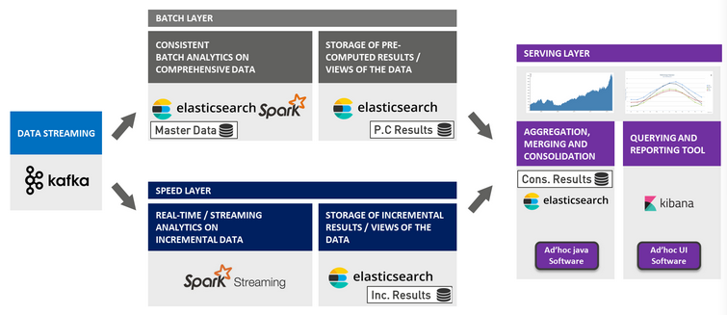
What is Software Archtecture?
Example: Lambda Architecture

Slide 8
Solutions
Building Blocks in an architecture
Each building block can be replaced by similar products that satisfies different requirements in terms of scale, security and throughput
For eample,
Micro Services: java Springbot, python Tornado e.t.c
Database: Mongodb, MySQL, PostgreSQL e.t.c.
frontend: HTML, reactjs, VUE etc.
Lambda:
Kafka Streaming-> Spark streaming/Strom / Flink
Spark -> Tenserfolw
Elastic Search -> Solr

